Slide 1

Göttingen Open Source & Science Initiative of Psychology
Working in a Local Open Science Initiative
Larissa Wieczorek | Goettingen Open Source and Science Initiative of Psychology
Sage Lab Meeting
2019 Jan 07

Slide 2
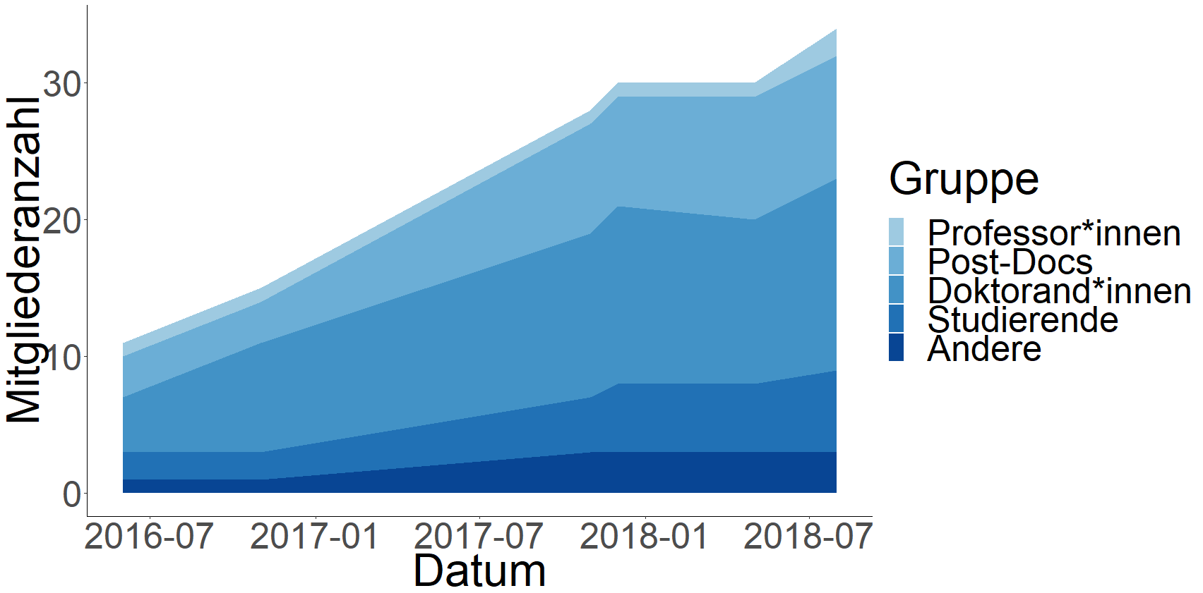
The History of GOSSIP
2016: Some institute members decided to form a group and support Open Science at their work space
Since then more than 30 members joined and most departments are represented
Group
Members
Professors
Post-docs
PHD students
Students
Others
Date
GOSSIP, 2018

Slide 3

Organizational Structure
Flat hierarchy
Everyone can join
2 meetings per semester (plus meetings in project groups)
Communication via e-mail mailing list
Task segregation/ responsibilities, e.g. newsletter team

Slide 4
GOSSIP‘s Fields of Commitment
Research
Teaching
Publicity
Committees

Slide 5
GOSSIP‘s Commitment
Research
Workshops about preregistration and the use of OS software
Invitation of OS experts for talks
Use of the OSF platform for knowledge exchange and connection with others
Listing of OS publications on the institute’s website
→ Motivate and support researchers in doing open science
GOSSIP, 2018

Slide 6
GOSSIP‘s Commitment
Preregistration and OS badges at the experimental practicum course (3nd semester Bachelor)
Courses about the replication crisis and OS (Bachelor + Master)
Support of OS practices and preregistration in students’ theses
Cooperation with the student’s council
Teaching
→ Teach best practices
and increase sensitivity for
non-optimal practices in published literature
GOSSIP, 2018

Slide 7
GOSSIP‘s Commitment
Website with news and OS resources:
www.psych.uni-goettingen.de/gossip
(German only)
Newsletter (distributed via mailing list, see archive on
GOSSIP website)
Presence at OS events, e.g. OS run, conferences, etc.
Make OS visible to the public and enlarge our network
Publicity
GOSSIP, 2018

Slide 8
GOSSIP‘s Commitment
OS as a criterion in job announcements and for recruitment
Seeking funding for OS activities
Anchoring OS in shared projects with other institutions and research infrastructures
Support and initiation of a student’s petition for more OS
at universities
→ Build a system that rewards OS practices
Committees
GOSSIP, 2018

Slide 9
What helps “opening the door” for OS? Recommendations by Tanja M. Gerlach (spokeswoman of GOSSIP)

Slide 10
When getting involved as department …
Do not be afraid of the overwhelming amount of information!
– Just get started with small steps towards OS
Usually you do not need to invent everything completely new
– Ask the OS community for templates and materials
– Talk to colleagues who do similar research to find solutions together
When following the improvement of OS practices in the media, it can feel as if you can never do it right
– Treat your own OS work as a continuous learning process
(shifting standards = always room for improvement ☺)
– In the past, reviewers and editors have usually valued OS efforts and gave helpful tips and pragmatic advice

Slide 11
When founding an initiative …
It might take a while to convince others to join
– Be persistent in bringing the topic to the agenda and do not give up
Respect other people’s concerns and the local possibilities (especially when trying to convince people in key positions)
– Encourage big AND small efforts
– „Foot in the door“ instead of „door in the face“: Try to jointly seek out new ways and offer help instead of acting like a know-it-all

Slide 12

Every little bit helps!
Always remember:

Slide 13
Some Resources to Learn About Open Science (there are many more!)
OS framework: https://osf.io/
Society for the Improvement of Psychological Science: http://improvingpsych.org/
FB group: https://www.facebook.com/groups/psychmap
Tutorials: http://spsp.org/resources/videos/openscience
Blog: http://datacolada.org/
Platform labeling articles regarding OS: http://curatescience.org/
Preprints: https://psyarxiv.com/
Twitter: @BrianNosek, @nicebread303, @LorneJCampbell, @lakens, ...
Take online courses and earn badges: https://www.fosteropenscience.eu/

Slide 14
References
Göttingen Open Source & Science Initiative of Psychology. (2018). Zwei Jahre Göttinger Open Source und Science Initiative der Psychologie – ein Erfahrungsbericht. In Deutsche Gesellschaft für Psychologie (DGPs). Frankfurt. Retrieved from https://www.psych.uni-goettingen.de/de/gossip/news/poster-auf-der-dgps-2018

